Slide 1



AUTOMATION WEB TESTING
TEAM MEMBER:
Waleed Abd ELnasser Bahr
Asmaa Abd Elmonem Maghraby

Slide 2
INTRODUCTION
In today's digital age, websites and web applications are critical for businesses
Ensuring their functionality, reliability, and performance is paramount
Automation testing plays a pivotal role in achieving these goals.

Slide 3
WHAT IS AUTOMATION TESTING?
• Automation testing involves using specialized tools and scripts to executetests on software applications.
• It automates the repetitive tasks involved in manual testing.
• In web automation testing, these tools simulate user interactions with web elements like buttons, forms, and links.

Slide 4


ADVANTAGES OF AUTOMATION TESTING
Efficiency boost: Automation testing automates routine tasks, allowing testers to focus on more intricate work.
Result consistency: Ensures consistent outcomes and minimizes mistakes from manual intervention.
Test management: Manages extensive and complex test cases efficiently.
Cost savings: Cuts down on overall testing expenses after the initial setup.

Slide 5
TYPES OF AUTOMATION TESTING
Unit Testing: Testing individual components or modules of the application
Integration Testing: Testing the interaction between different modules or systems.
Functional Testing: Validating the functionality of the application against specified requirements.
Regression Testing: Ensuring that recent changes to the codebase haven't affected existing functionalities.
Performance Testing: Assessing the responsiveness and stability of the application under various loads.

Slide 6
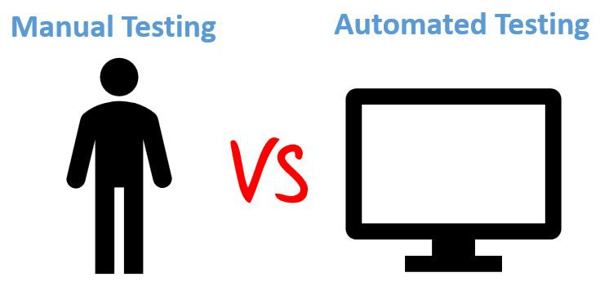
MANUAL VS. AUTOMATION TESTING

Slide 7
MANUAL VS. AUTOMATION TESTING
• Relies on human testers to execute testcase.
• Time-consuming and prone to errors.
• Suitable for exploratory testing and user experience evaluation.
Relies on tools and scripts to execute test cases.
Faster and more accurate than manual testing.
Ideal for repetitive tests, regression testing, and large-scale projects.

Slide 8
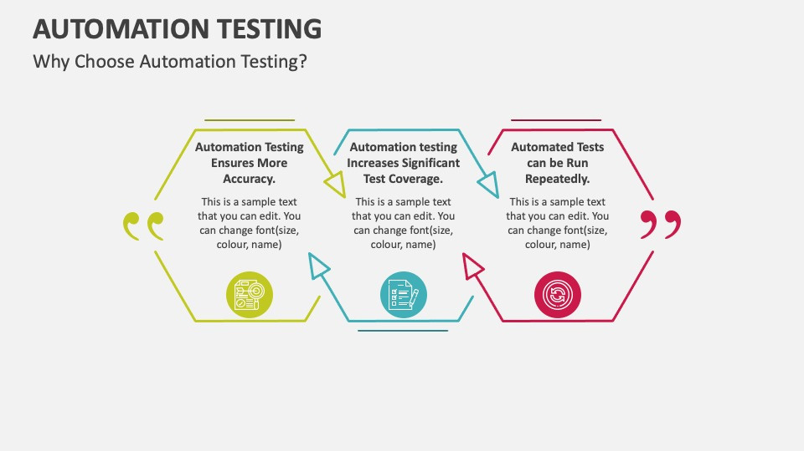

Slide 9
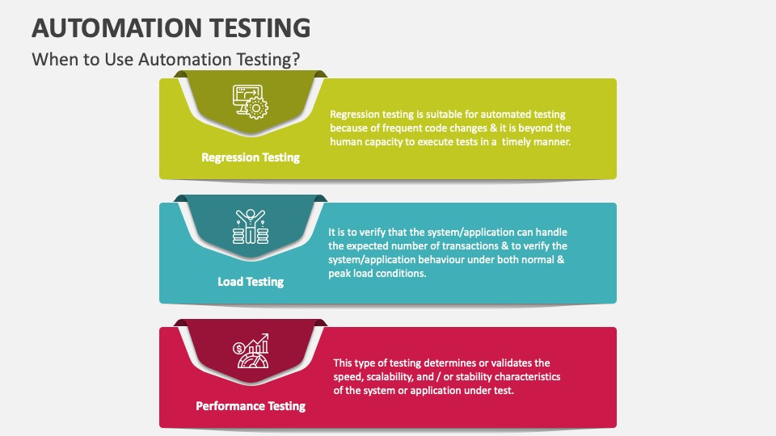

Slide 10
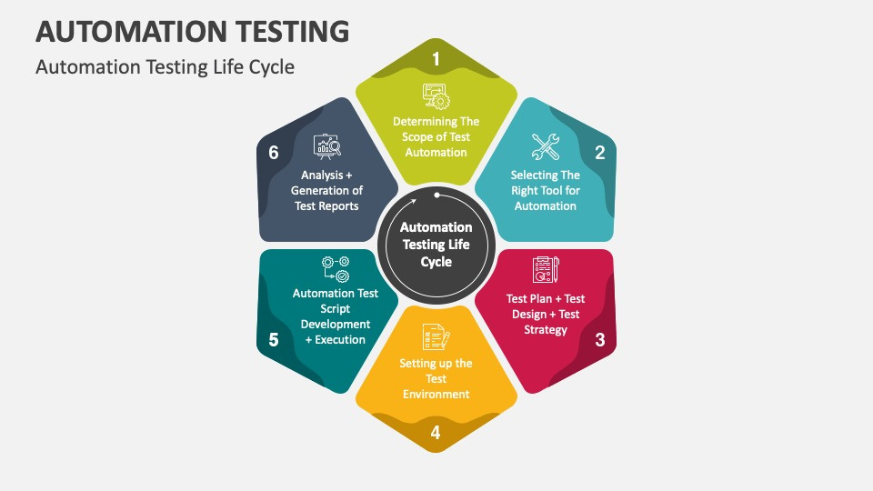

Slide 11
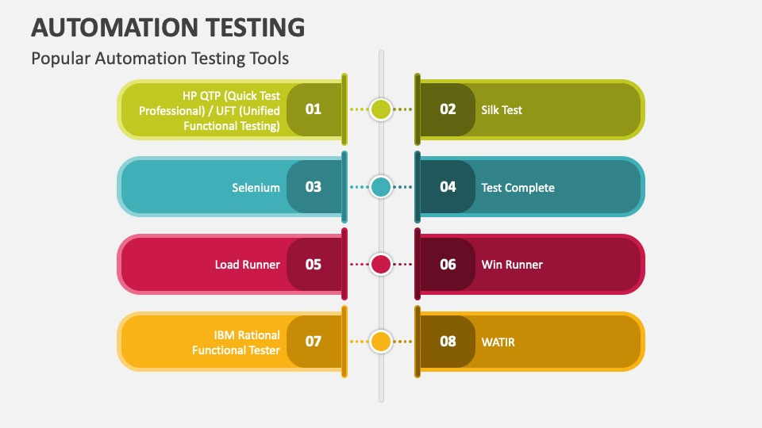

Slide 12
CONCLUSION
Regardless of whichever testing type your testing team focuses on, neither of the testing techniques can be entirely eliminated. It becomes inevitable for testers to rely on manual testing in the initial development phases, while automation is leveraged in areas of continuous tests, repeated processes, and tasks that need to be performed with time and resource limitations.

Slide 13
THANK YOU

